Slide 1

Deep Learning for Natural Language Processing:
Recurrent Neural Network
Rang Nguyen
June 2019

Slide 2
Overview
Introduce a new NLP task
Language Modeling
Introduce a new family of neural networks
Recurrent Neural Networks (RNNs)

Slide 3
Language Modeling

Slide 4
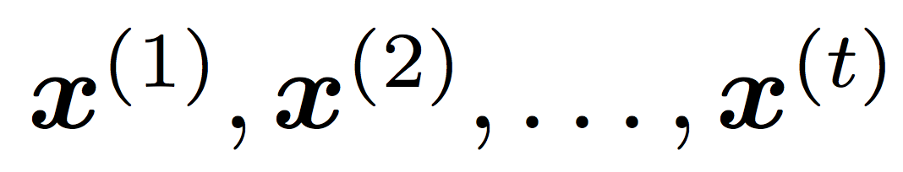
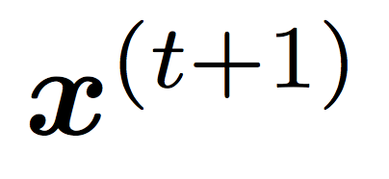
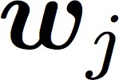
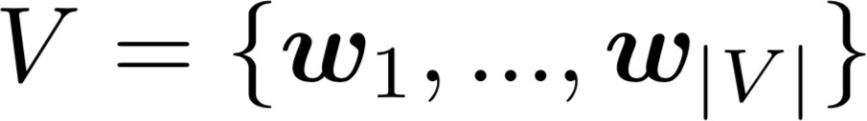
Language Modeling
Language Modeling is the task of predicting what word comes
next.
books
laptops
the students opened their
exams
minds
More formally: given a sequence of words
compute the probability distribution of the next word
,
:
where is a word in the vocabulary
A system that does this is called a Language Model.

Slide 5
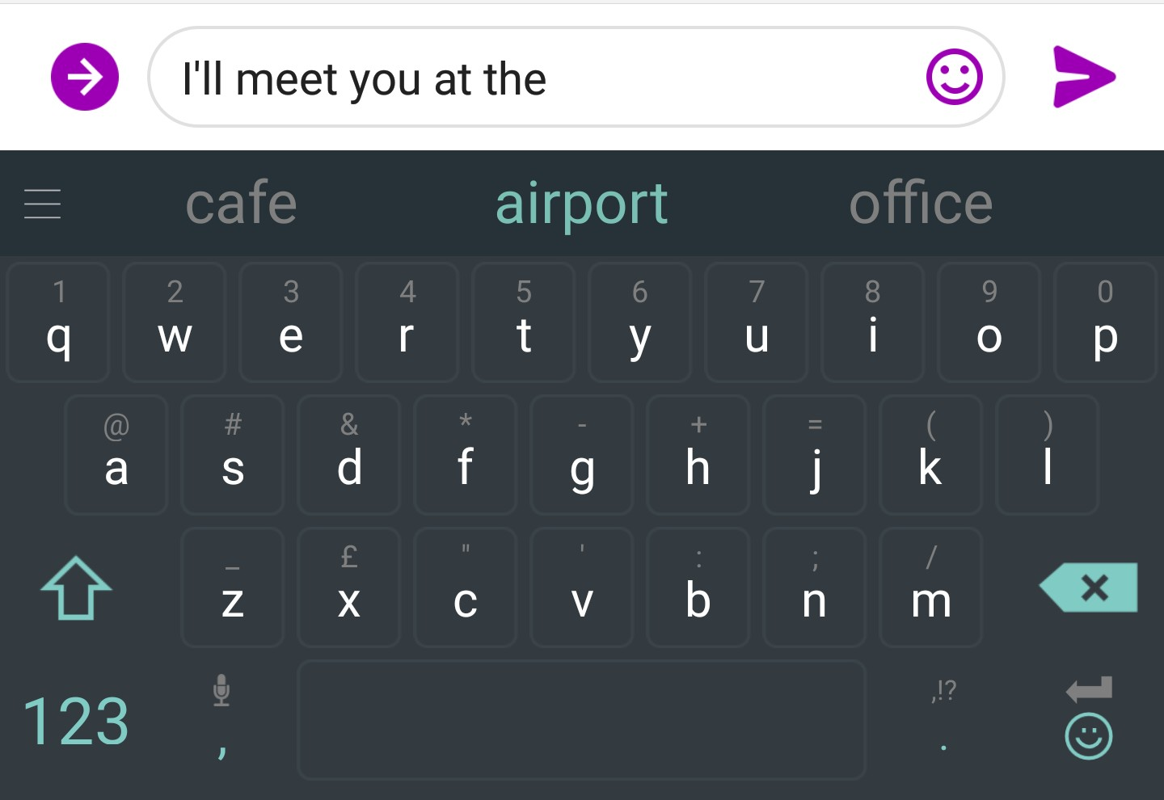
You use Language Models every day!

Slide 6
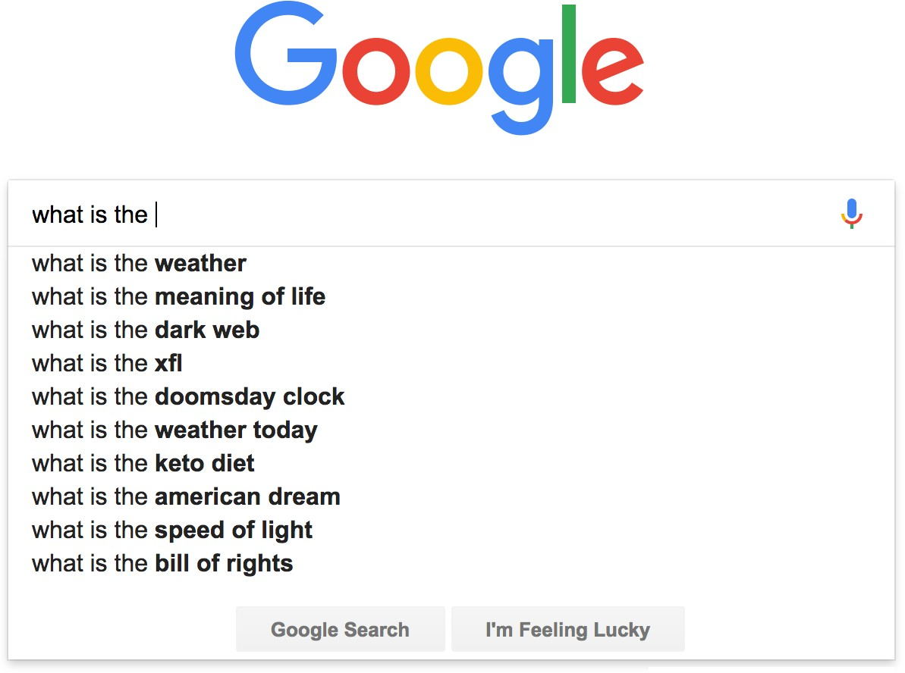
You use Language Models every day!

Slide 7
n-gram Language Models
the students opened their
Question: How to learn a Language Model?
Answer (pre- Deep Learning): learn a n-gram Language Model!
Definition: A n-gram is a chunk of n consecutive words.
unigrams: “the”, “students”, “opened”, ”their”
bigrams: “the students”, “students opened”, “opened their”
trigrams: “the students opened”, “students opened their”
4-grams: “the students opened their”
Idea: Collect statistics about how frequent different n-grams are, and use these to predict next word.

Slide 8
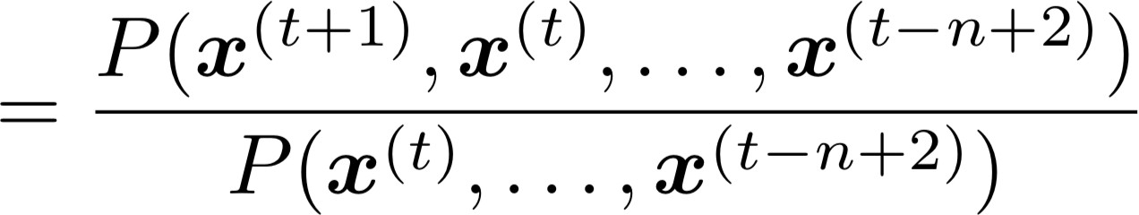
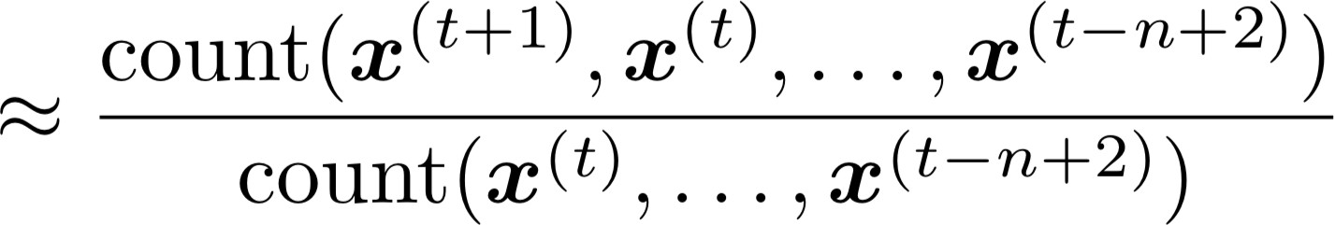
n-gram Language Models
First we make a simplifying assumption: preceding (n-1) words
n-1 words
depends only on the
(assumption)
prob of a n-gram
(definition of conditional prob)
prob of a (n-1)-gram
Question: How do we get these n-gram and (n-1)-gram probabilities?
Answer: By counting them in some large corpus of text!
(statistical approximation)

Slide 9
n-gram Language Models
Suppose we are learning a 4-gram Language Model.
as the proctor started the clock, the
students opened their
condition on this
discard
In the corpus:
“students opened their” occurred 1000 times
“students opened their books” occurred 400 times
→ P(books | students opened their) = 0.4
“students opened their exams” occurred 100 times
→ P(exams | students opened their) = 0.1
Should we have discarded the “proctor” context?

Slide 10
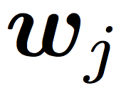
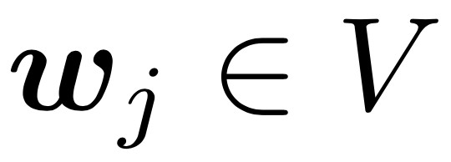
Problems with n-gram Language Models
Sparsity Problem 1
Problem: What if “students opened their ” never occurred in data? Then
has probability 0!
(Partial) Solution: Add small 𝛿
to count for every . This is called smoothing.
Sparsity Problem 2
Problem: What if “students opened their” never occurred in data? Then we can’t calculate probability for any !
(Partial) Solution: Just condition on “opened their” instead.
This is called backoff.
Note: Increasing n makes sparsity problems worse.
Typically we can’t have n bigger than 5.

Slide 11
Problems with n-gram Language Models
Storage: Need to store count for all possible n-grams. So model size is O(exp(n)).
Increasing n makes model size huge!

Slide 12
n-gram Language Models in practice
You can build a simple trigram Language Model over a
1.7 million word corpus (Reuters) in a few seconds on your laptop*
Business and financial news
today the
get probability distribution
company |  | 0.153
bank |  | 0.153
price |  | 0.077
italian |  | 0.039
emirate | … | 0.039
Sparsity problem: not much granularity in the probability distribution
* Try for yourself: https://nlpforhackers.io/language-models/
Otherwise, seems reasonable!

Slide 13
Generating text with a n-gram Language Model
You can also use a Language Model to generate text.
today the
condition on this
get probability distribution
company bank price italian emirate
0.153
0.153
0.077 sample
0.039
0.039
…

Slide 14
Generating text with a n-gram Language Model
You can also use a Language Model to generate text.
today the price
condition on this
get probability distribution
of for it to is
0.308
0.050
0.046
0.046
0.031
sample
…

Slide 15
Generating text with a n-gram Language Model
You can also use a Language Model to generate text.
today the price of
condition on this
get probability distribution
the 18
oil its gold
0.072
0.043
0.043
0.036
0.018
sample
…

Slide 16
Generating text with a n-gram Language Model
You can also use a Language Model to generate text.
today the price of gold

Slide 17
Generating text with a n-gram Language Model
You can also use a Language Model to generate text.
today the price of gold per ton , while production of shoe lasts and shoe industry , the bank intervened just after it considered and rejected an imf demand to rebuild depleted european stocks , sept 30 end primary 76 cts a share .
Incoherent! We need to consider more than 3 words at a time if we want to generate good text.
But increasing n worsens sparsity problem, and exponentially increases model size…

Slide 18
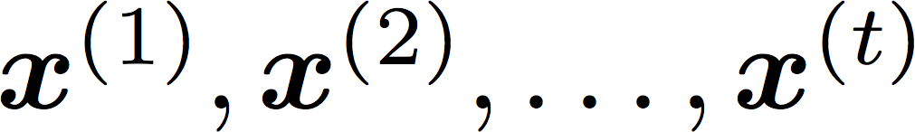
How to build a neural Language Model?
Recall the Language Modeling task:
Input: sequence of words
Output: prob dist of the next word
How about a window-based neural model?
We saw this applied to Named Entity Recognition in Lecture 4

Slide 19
A fixed-window neural Language Model
as the proctor started the clock
the students opened
fixed window
their
discard

Slide 20


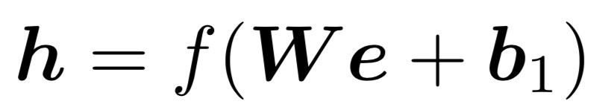







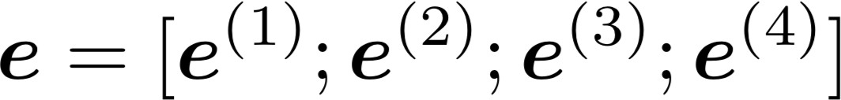






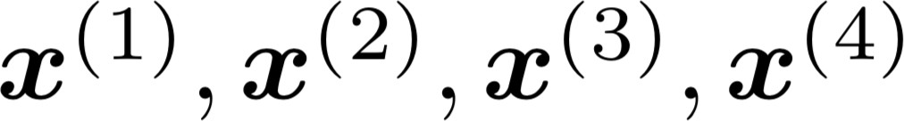
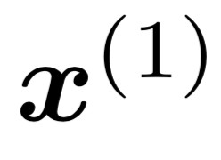
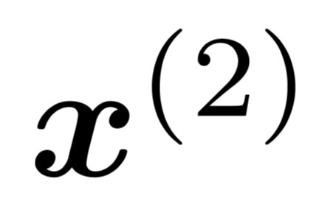
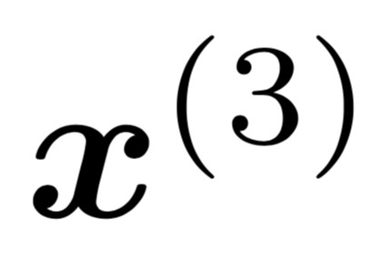
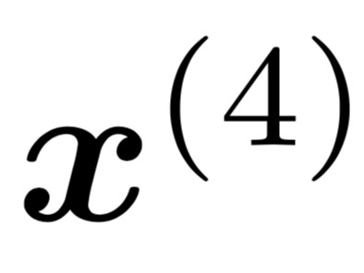
A fixed-window neural Language Model
books
laptops
output distribution
a
zoo
hidden layer
concatenated word embeddings
words / one-hot vectors
the students
opened
their

Slide 21

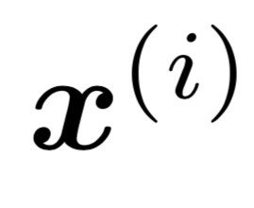
A fixed-window neural Language Model
Improvements over n-gram LM:
No sparsity problem
Model size is O(n) not O(exp(n))
books
laptops
Remaining problems:
Fixed window is too small
Enlarging window enlarges
Window can never be large enough!
Each uses different rows of . We don’t share weights across the window.
a
zoo
We need a neural architecture that can process any length input
the students
opened
their

Slide 22
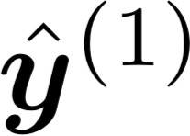
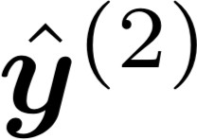
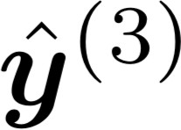
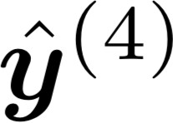
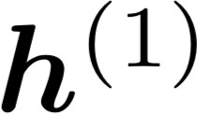
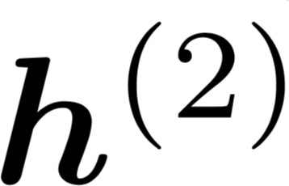
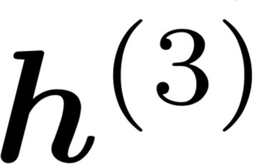
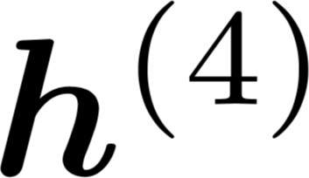


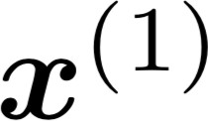
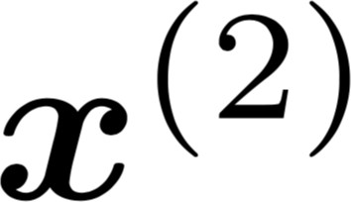
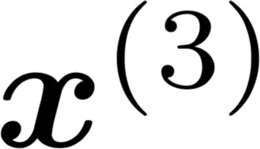
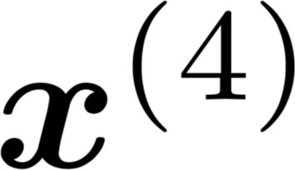
Core idea: Apply the same weights repeatedly
Recurrent Neural Networks (RNN)
A family of neural architectures
outputs (optional)
…
hidden states
…
input sequence (any length)
…

Slide 23
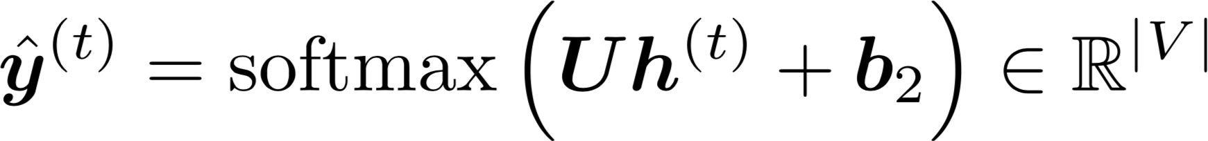


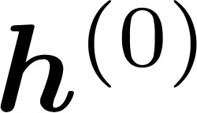


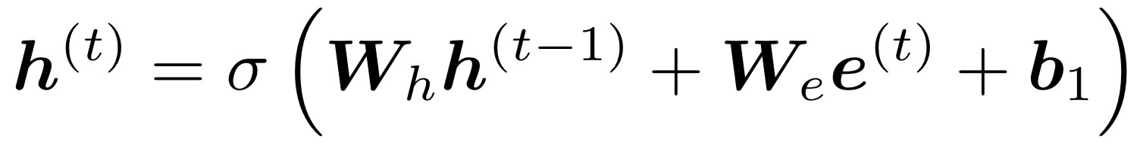
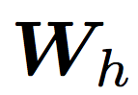





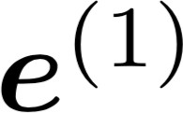
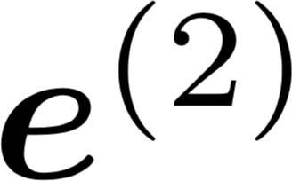
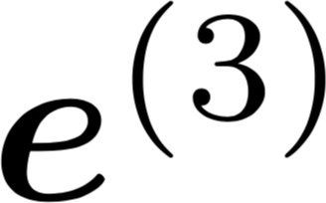
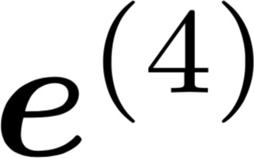
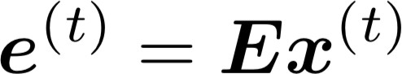


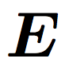
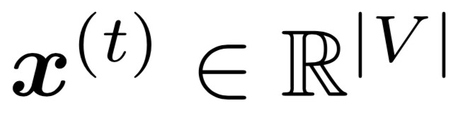
A RNN Language Model
books
laptops
output distribution
a
zoo
hidden states
is the initial hidden state
word embeddings
words / one-hot vectors the students
opened
their
Note: this input sequence could be much longer, but this slide doesn’t have space!
25
2/1/18

Slide 24
A RNN Language Model
books
laptops
RNN Advantages:
Can process any length input
Model size doesn’t increase for longer input
Computation for step t can (in theory) use information from many steps back
Weights are shared across timesteps →  representations are shared
a
zoo
RNN Disadvantages:
Recurrent computation is slow
In practice, difficult to access information from
₂₆many steps back
More on these next week
the students
opened
their
2/1/18

Slide 25
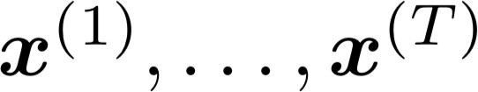
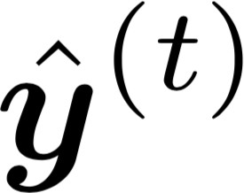
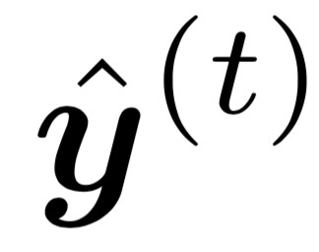
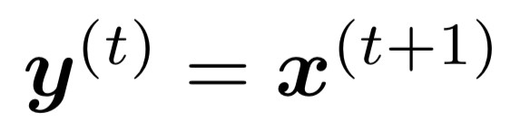
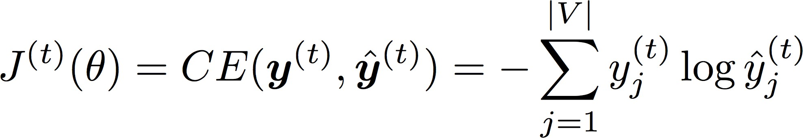
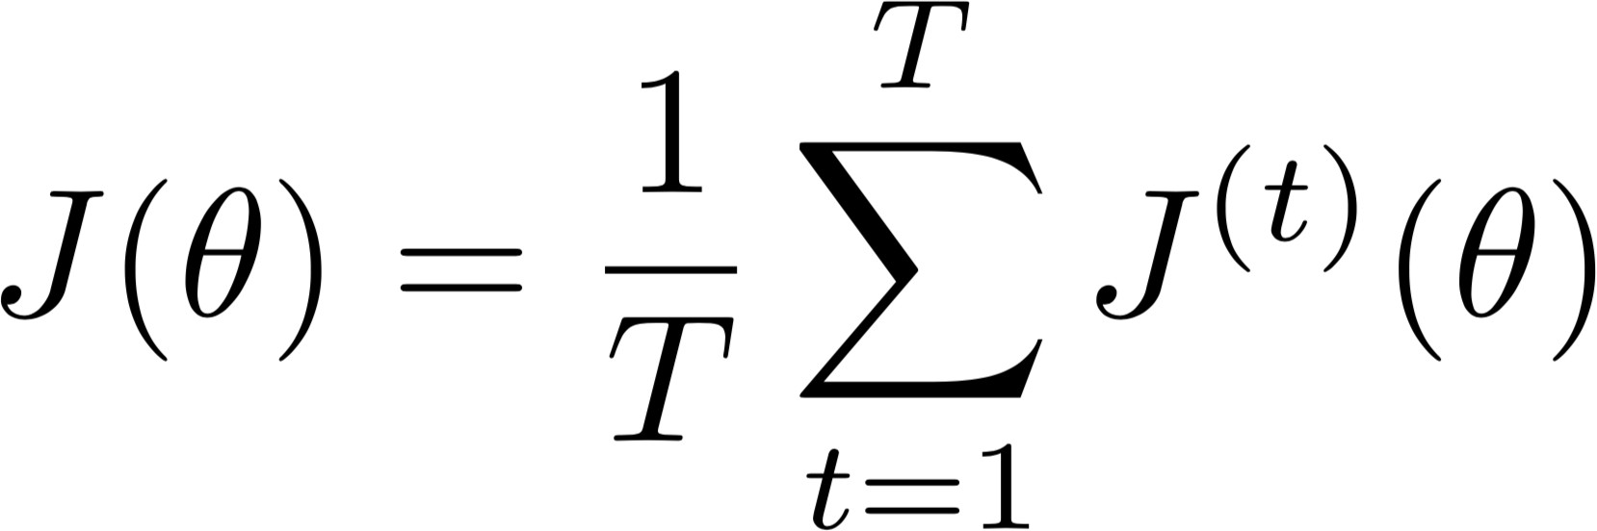
Training a RNN Language Model
Get a big corpus of text which is a sequence of words
Feed into RNN-LM; compute output distribution
for every step t.
i.e. predict probability dist of every word, given words so far
Loss function on step t is usual cross-entropy between our predicted probability distribution , and the true next word :
Average this to get overall loss for entire training set:

Slide 26
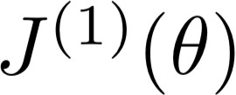
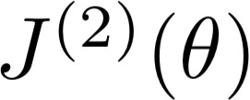





Training a RNN Language Model
= negative log prob of “students”
Loss
…
Corpus
the
students
opened
their
exams
…

Slide 27
Training a RNN Language Model
= negative log prob of “opened”
Loss
…
Corpus
27
the
students
opened
their
exams
2/1/18
…

Slide 28
Training a RNN Language Model
= negative log prob of “their”
Loss
…
Corpus
the
students
opened
their
exams
…

Slide 29
Training a RNN Language Model
= negative log prob of “exams”
Loss
…
Corpus
the
students
opened
their
exams
…

Slide 30
Training a RNN Language Model
Loss
+
+
+
+ … =
…
Corpus
the
students
opened
their
exams
…

Slide 31

Training a RNN Language Model
However: Computing loss and gradients across entire corpus is too expensive!
Recall: Stochastic Gradient Descent allows us to compute loss and gradients for small chunk of data, and update.
→ In practice, consider as a sentence
Compute loss for a sentence (actually usually a batch of sentences), compute gradients and update weights. Repeat.

Slide 32




Backpropagation for RNNs
…
…
Question: What’s the derivative of weight matrix ?
Answer:
w.r.t. the repeated
“The gradient w.r.t. a repeated weight is the sum of the gradient
w.r.t. each time it appears”
Why?

Slide 33


Multivariable Chain Rule
Source:
https://www.khanacademy.org/math/multivariable-calculus/multivariable-derivatives/differentiating-vector-valued-functions/a/multivariable-chain-rule-simple-version

Slide 34







Backpropagation for RNNs: Proof sketch
In our example:
Apply the multivariable chain rule:
= 1
…
Source:
https://www.khanacademy.org/math/multivariable-calculus/multivariable-derivatives/differentiating-vector-valued-functions/a/multivariable-chain-rule-simple-version

Slide 35




Backpropagation for RNNs
…
…
Answer: Backpropagate over timesteps i=t,…,0, summing gradients as you go.
This algorithm is called
“backpropagation through time”
Question: How do we calculate this?

Slide 36
Generating text with a RNN Language Model
Just like a n-gram Language Model, you can use a RNN Language Model to generate text by repeated sampling. Sampled output is next step’s input.
favorite
sample
season
sample
is
sample
spring
sample
…
my
favorite
season
is
spring

Slide 37


Generating text with a RNN Language Model
Let’s have some fun!
You can train a RNN-LM on any kind of text, then generate text in that style.
RNN-LM trained on Obama speeches:
Source: https://medium.com/@samim/obama-rnn-machine-generated-political-speeches-c8abd18a2ea0

Slide 38


Generating text with a RNN Language Model
Let’s have some fun!
You can train a RNN-LM on any kind of text, then generate text in that style.
RNN-LM trained on Harry Potter:
Source: https://medium.com/deep-writing/harry-potter-written-by-artificial-intelligence-8a9431803da6

Slide 39


Generating text with a RNN Language Model
Let’s have some fun!
You can train a RNN-LM on any kind of text, then generate text in that style.
RNN-LM trained on Seinfeld scripts:
Source: https://www.avclub.com/a-bunch-of-comedy-writers-teamed-up-with-a-computer-to-1818633242

Slide 40


Generating text with a RNN Language Model
Let’s have some fun!
You can train a RNN-LM on any kind of text, then generate text in that style.
(character-level) RNN-LM trained on paint colors:
Source: http://aiweirdness.com/post/160776374467/new-paint-colors-invented-by-neural-network

Slide 41

Evaluating Language Models
The traditional evaluation metric for Language Models is perplexity.
Normalized by number of words
Inverse probability of dataset
Lower is better!
In Assignment 2 you will show that minimizing perplexity and minimizing the loss function are equivalent.

Slide 42

RNNs have greatly improved perplexity
n-gram model
Increasingly complex RNNs
Perplexity improves (lower is better)
Source: https://research.fb.com/building-an-efficient-neural-language-model-over-a-billion-words/

Slide 43
Why should we care about Language Modeling?
Language Modeling is a subcomponent of other NLP systems:
Speech recognition
Use a LM to generate transcription, conditioned on audio
Machine Translation
Use a LM to generate translation, conditioned on original text
Summarization
Use a LM to generate summary, conditioned on original text
These systems are called conditional Language Models
Language Modeling is a benchmark task that helps us measure our progress on understanding language

Slide 44
Recap
Language Model: A system that predicts the next word
Recurrent Neural Network: A family of neural networks that:
Take sequential input of any length
Apply the same weights on each step
Can optionally produce output on each step
Recurrent Neural Network ≠ Language Model
We’ve shown that RNNs are a great way to build a LM.
But RNNs are useful for much more!

Slide 45

RNNs can be used for tagging
e.g. part-of-speech tagging, named entity recognition
DT
VBN
NN
VBN
IN
DT
NN
the
startled
cat
knocked
over
the
vase

Slide 46



RNNs can be used for sentence classification
positive
How to compute sentence encoding?
e.g. sentiment classification
Sentence encoding
overall
I
enjoyed
the
movie
a
lot

Slide 47

RNNs can be used for sentence classification
positive
How to compute sentence encoding?
e.g. sentiment classification
Basic way:
Use final hidden state
Sentence encoding
overall
I
enjoyed
the
movie
a
lot

Slide 48
RNNs can be used for sentence classification
positive
How to compute sentence encoding?
e.g. sentiment classification
Usually better:
Take element-wise max or mean of all hidden states
Sentence encoding
overall
I
enjoyed
the
movie
a
lot

Slide 49

RNNs can be used to generate text
e.g. speech recognition, machine translation, summarization
what’s
the weather
<START>
what’s
the
Remember: these are called “conditional language models”. We’ll see Machine Translation in much more detail later.

Slide 50



RNNs can be used as an encoder module
Answer: German
e.g. question answering, machine translation
Question encoding
= element-wise max of hidden states
Context: Ludwig van Beethoven was a German composer and pianist. A crucial figure …
Here the RNN acts as an encoder for the Question. The encoder is part of a larger neural system.
Question: what
nationality was
Beethoven
?

Slide 51








A note on terminology
RNN described in this lecture = “vanilla RNN”
Next lecture: You will learn about other RNN flavors
like GRU and LSTM
and multi-layer RNNs
By the end of the course: You will understand phrases like
“stacked bidirectional LSTM with residual connections and self-attention”

Slide 52
Next time
Problems with RNNs!
Vanishing gradients
motivates
Fancy RNN variants!
LSTM
GRU
multi-layer
bidirectional

